Slide 1
USERS SOCIAL NETWORKING WEBSITE

Slide 2
GROUP MEMBERS
GIRISH SHENOY

Slide 3
SYSTEM SPECIFICATION
Software Requirements: -
Front End: HTML5/CSS3/JavaScript
Back End: MySQL /PHP
Tools: Sublime Text , XAMPP, TOMCAT
Hardware Requirements :-
Processor – AMD AMD E1-6010 APU 1.35 GHz , Intel® Core™2 Duo Processor E7500
System RAM – 2 GB Minimum
Storage – 80 GB HDD Minimum

Slide 4
OBJECTIVES
THE MAIN OBJECTIVE OF SOCAIL NETWORKING WEBSITE IS TO MANAGE DETAILS OF USERS, VIDEOS,PHOTOS, FRIENDS.
THE PURPOSE OF THE PROJECT IS TO BUILD AN WEB APPLICATION PROGRAM TO REDUCE THE MANUAL WORK FOR MANAGING USERS , PHOTOS ,VIDEOS.

Slide 5
SOCAIL NETWORKING INVOLVES THE DEVELOPMENT AND MAINTENANCE OF PERSONAL AND BUSINESS RELATIONSHIP USING TECHNOLOGY.
SOCAIL NETWORKING TRACKS THE DETAILS ABOUT PHOTOS,VIDEOS,POSTS

Slide 6
FUNCTIONALITIES
PROVIDES THE SEATCHING FACILITIES BASED ON VARIOUS FACTORS SUCH AS USERS ,PHOTOS,VIDEOS.
IT TRACKS INFORMATION ABOUT VIDEOS ,PHOTOS, MUSIC,POSTS.
ALL THE FIELDS ARE VALIDATED LIKE USERS,FRIENDS,MUSIC,VIDEOS ARE VALIDATED AND DOES NOT TAKE INVALID VALUES.
IT GENERATES THE REPORTS OF USERS,PHOTOS,MUSIC,VIDEO ,POSTS.

Slide 7
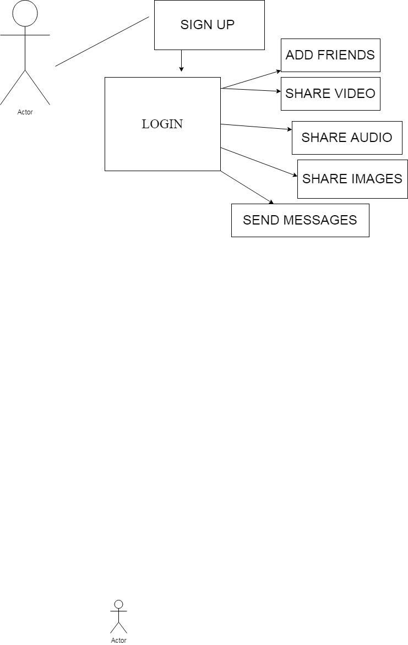

Slide 8
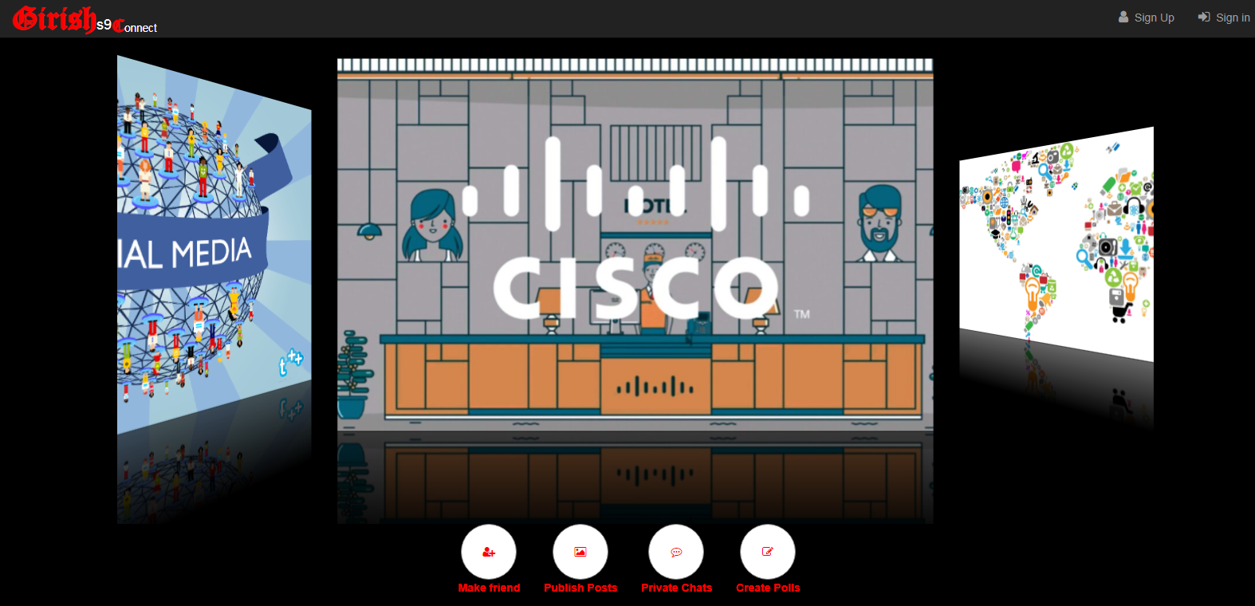
aPPLICATIONS

Slide 9
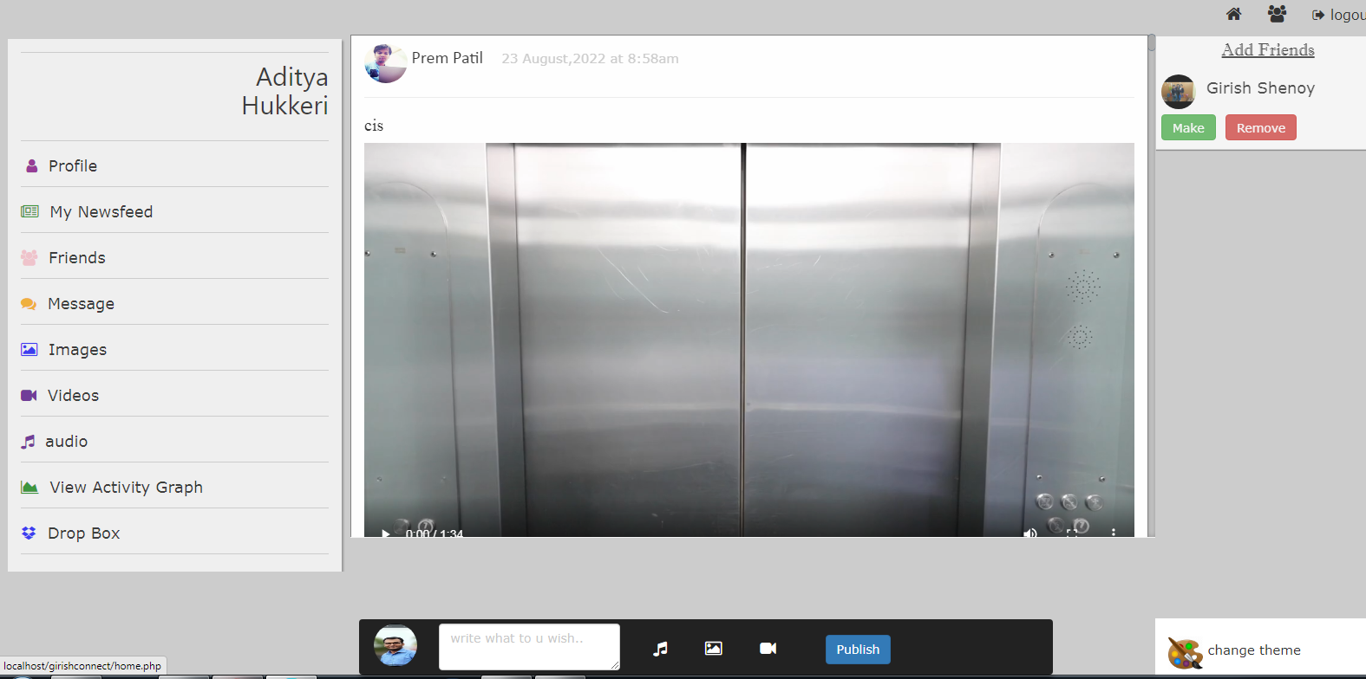

Slide 10
cONCLUSION
Social media is a really convenient and important communicate network for all the people nowadays. We can use it to know friends and keep contact with friends that came from different countries. We can also share our ideas so quickly so that all the things could develop so fast because people could tell us their ideas and we could improve it immediately. We could also learn new things on social media by watching or reading the things that people shared onto the social media.
Social media is used by millions of individuals who collectively generate an array of social forms from their interactions. Social media network maps can be useful in understanding the variety of social structures that emerge. Network maps can reveal the structures of the crowd and highlight strategic locations or roles in these webs of connection. By mapping social media network spaces, researchers and practitioners can learn about the most common and best uses for these communication services.

